Slide 1
2018
TINY HOUSES
BRENT LAWSON
STATE PLUMBING INSPECTOR
SUBSURFACE WASTEWATER

Slide 2
SUBSURFACE
D. DESIGN FLOWS
The design flows provided in this Section are based on empirical data collected over many years by numerous researchers. These design flows reflect system designs proven to function adequately over long periods of time. As such, these design flows anticipate variations in flow among different establishments of the same class as well as flow variations over time in the same establishment. These design flows also assume wastewater with strengths typical of the class of establishment.

Slide 3
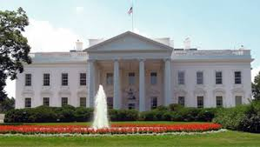
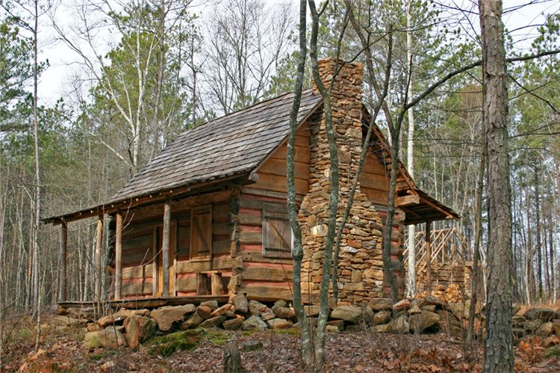
MINIMUM
2 BEDROOMS
180- GPD

Slide 4
HOW IS THIS CALCULATED???
2 BEDROOMS = 180 GPD

Slide 5
HOW IS THIS CALCULATED???
Stratified Glacial Drift | 5 | Loam to loamy sand textured upper horizons overlying fine and medium sand parent materials. Stratified horizons of water-sorted materials may be present. Lower horizons tend to be granular or massive. Entire profile tends to be loose except that saturated horizons may be cemented and therefore firm and are considered hydraulically restrictive. Horizons with rounded rock fragments are common. | 2.6 S.F. Medium
2 BEDROOMS = 180 GPD
180
X
2.6
468 SQUARE FEET
25’
STONE
BED
20’
FULL SYSTEM 500 sq. ft.

Slide 6
HOW IS THIS CALCULATED???
System, primitive:
A primitive disposal system consists of a grey-water disposal field designed to only handle
hand carried or hand pumped water with an alternative toilet.
NO SEPTIC TANK NEEDED
25 gallons of grey wastewater per day
not more than 3 grey wastewater fixtures
System, limited:
A limited system consists of a grey wastewater disposal field to handle water supplied from elevated
storage tanks or cisterns of no more than
1,000 gallons capacity, and portable pumps, among other non-conventional pressurized water supplies, and an alternative toilet.
SEPTIC TANK REQUIRED
100 gallons of grey wastewater per day
not more than 3 grey wastewater fixtures

Slide 7
HOW IS THIS CALCULATED???
Stratified Glacial Drift | 5 | Loam to loamy sand textured upper horizons overlying fine and medium sand parent materials. Stratified horizons of water-sorted materials may be present. Lower horizons tend to be granular or massive. Entire profile tends to be loose except that saturated horizons may be cemented and therefore firm and are considered hydraulically restrictive. Horizons with rounded rock fragments are common. | 2.6 S.F. Medium
2 BEDROOMS = 180 GPD
180
X
2.6
468 SQUARE FEET
25’
Primitive= 25 GPD x 2.6 = 65 sq. ft.
STONE
BED
20’
10’ x 10’ = 100 sq. ft.
Limited = 100 GPD x 2.6 = 260 sq. ft.
FULL SYSTEM 500 sq. ft.
15’ x 20’ = 300 sq. ft.

Slide 8
SECTION 4
DESIGN CRITERIA
P. GREY WASTEWATER DISPOSAL SYSTEMS
The LPI may approve a grey wastewater disposal system for single-family dwelling units served by pressurized water
Septic tank or filter required
MIN. DESIGN FOR A SINGLE FAMILY GREY WASTEWATER DISPOSAL FIELD
126 GPD
MIN. DESIGN FOR A SINGLE FAMILY LAUNDRY DISPOSAL FIELD
55 GPD
GREY WASTEWATER SYSTEM - #5 SOIL = 2.6 SQ. FT. X 126 GPD = 327.6 SQ. FT.
15’
20’
375 SQ. FT.

Slide 9
WATER USE DATA
Use records:
The design flow may be calculated from appropriate water use data, provided the following procedures are used:
Acceptable records:
Data is collected from billing records of the service provider or from water meters certified to be accurate within 2 percent;
1 year minimum:
Continuous records over a period of at least one 1year, or operating season (or other period acceptable to the Department) are utilized;
Like establishments: Records from the applicant’s facilities or from a like establishment are utilized.
Adjustments for peak days

Slide 10
SECTION 4
DESIGN CRITERIA
Sec. I- #3
PRIMITIVE & LIMITED DISPOSAL SYSTEMS
Use of alternative toilets:
An alternative toilet must be used if a primitive or limited disposal field is used. An alternative toilet may also be used with a conventional disposal system.

Slide 11
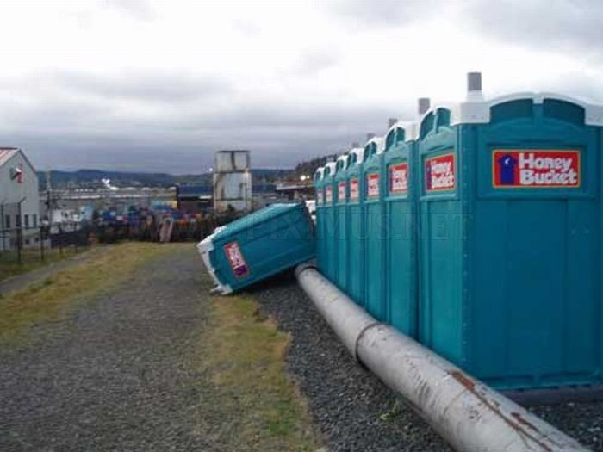
SECTION 4
DESIGN CRITERIA
M. ALTERNATIVE TOILETS
(b) Types of alternative toilets:
Alternative toilets include chemical toilets and privies, composting toilets which discharge leachate, incineration toilets, pit privies, and vault privies.
Temporary portable toilets are not alternative toilets and shall not be used as permanent alternative toilets

Slide 12
WHAT DOES THE UPC STATE ABOUT ALTERNATIVE TOILETS?
THE UPC DOES NOT DEFINE WATER CLOSET OR TOILETS
Dictionary
WATER CLOSET
wa·ter clos·et
noundated
noun: water closet; plural noun: water closets
a flush toilet.
a room containing a flush toilet.
Translate WATER CLOSET to
SWEDISH
wa·ter clos·et
noundated
noun: water closet; plural noun: water closets
a flush toilet.
a room containing a flush toilet.
Translate water closet to
noun
1. vattenklosett
2. toalett

Slide 13
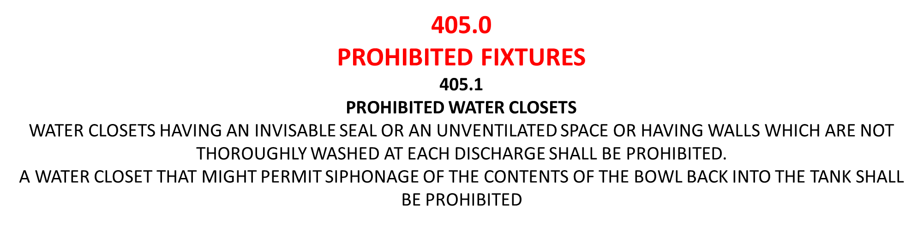
405.3
MISCELLANEOUS FIXTURES
NO DRY OR CHEMICAL CLOSET (TOILET) SHALL BE INSTALLED IN A BUILDING USED FOR HUMAN HABITATION, UNLESS FIRST APPROVED BY THE HEALTH OFFICER
413.0
FLUSHING DEVICES
413.3
FLUSH TANKS
FLUSH TANKS FOR MANUAL FLUSHING SHALL BE EQUIPED WITH A FLUSH VALVE IN ACCORDANCE WITH …..

Slide 14
UPC
TABLE 422.1
MINIMUM PLUMBING FACILITIES
TYPE OF OCCUPANCY
R-3 RESIDENTIAL OCCUPANCY
(ONE AND TWO FAMILY DWELLINGS)
WATER CLOSET – 1 PER ONE AND TWO FAMILY DWELLING
LAVATORIES – 1 PER ONE AND TWO FAMILY DWELLING
BATHTUBS OR SHOWERS – 1 PER ONE AND TWO FAMILY DWELLING
OTHER – 1 KITCHEN SINK AND 1 AUTOMATIC CLOTHES WASHER CONNECTION PER ONE AND TWO FAMILY DWELLING
PRIMITIVE = 3 FIXTURES
TOTAL = 5 FIXTURES
LIMITED = 3 FIXTURES

Slide 15
SO, THE QUESTION IS;
CAN I USE AN ALTERNATIVE TOILET IN A DWELLING?
YES VIRGINIA
AS LONG AS ITS APPROVED BY THE HEALTH OFFICER
And
  ITS DESIGNED FOR A GREY WASTEWATER SYSTEM AND AN ALTERNATIVE TOILET

Slide 16

A VARIANCE COULD BE ASKED FOR THE SUBSURFACE RULES
?

Slide 17
TINY HOUSES
BRENT LAWSON
STATE PLUMBING INSPECTOR
SUBSURFACE WASTEWATER

